Slide 1
Employee Data Analysis using Excel
STUDENT NAME: YUVA BHARATHI.R
REGISTER NO:1829A87F3DED8B9A96B47D7AC3158A53,312208820
DEPARTMENT: B.COM[GENERAL]
COLLEGE: MEENAKSHI COLLEGE FOR WOMEN

Slide 2
PROJECT TITLE
Employee Performance Analysis Based On Genders , Department And FTE using Excel

Slide 3


AGENDA
Problem Statement
Project Overview
End Users
Our Solution and Proposition
Dataset Description
Modelling Approach
Results and Discussion
Conclusion
3/21/2024 Annual Review

Slide 4

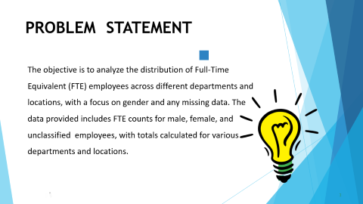
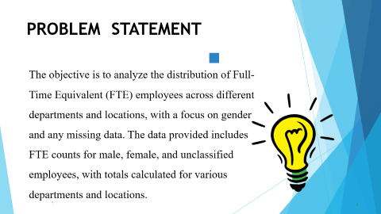
PROBLEM STATEMENT
The objective is to analyze the distribution of Full-Time Equivalent (FTE) employees across different departments and locations, with a focus on gender and any missing data. The data provided includes FTE counts for male, female, and unclassified employees, with totals calculated for various departments and locations.

Slide 5

PROJECT OVERVIEW
The overall data shows a grand total of 85.4 Female FTEs, 83.7 Male FTEs, and 5.9 FTEs with unspecified gender, summing up to a total of 175 FTEs across all departments. Accompanying the pivot table is a bar chart that visually represents the FTE distribution by gender across the different departments.

Slide 6

WHO ARE THE END USERS
HR MANAGERS
ACCOUNTANTS
DATA ANALYSTS
DEPARTMENT HEADS
PAYROLL ADMINISTRATORS
RECRUITMENT TEAMPROJECTAND
OPERATION MANAGERS

Slide 7

OUR SOLUTION AND ITS VALUE PROPOSITION
FILTERING- REMOVE VALUES
PIVOT TABLE- SUMMARY OF
EMPLOYEE PERFORMANCE
BAR DIAGRAM-FINAL REPORT

Slide 8
Dataset Description EMPLOYEE DATA SET-NAAN MUDHALVAN PORTAL 9FEATURES EMPLOYEE ID:ALPHA, NUMERICAL NAME:ALPHABETICAL[TEXT] SALARY:NUMERICAL START DATE –ALPHA, NUMERICAL EMPLOYEE TYPE –ALPHABETICAL[TEXT] EMPLOYEE LOCATION –ALPHABETICAL[TEXT] 3FEATURES USED: GENDER: ALPHABETICAL[TEXT] DEPARTMENT:ALPHABETICAL[TEXT] FTE -NUMERICAL

Slide 9

THE "WOW" IN OUR SOLUTION
The "wow" factor in your solution its ability to provide a comprehensive, intuitive view of workforce distribution through a detailed PivotTable and dynamic bar chart. This setup allows users to easily analyze FTE data by department and gender, offering both high-level summaries and detailed insights. The interactive features enable real-time customization, making it a powerful tool for informed decision-making and effective workforce management.
3/21/2024 Annual Review
9

Slide 10
MODELLING
STEP-1: DOWNLOAD THE EMPLOYEE DATASET IN NAAN MUDHALVAN PORTAL AND OPEN THE EXCEL.
STEP-2: SELECT THE DATA AND CLICK ON FILTER OPTION.
STEP-3: FILTER FTP IN ASSCENDING ORDER(A TO Z).
STEP-4: SELECT THE ENTIRE DATA AND CLICK ON INSERT AND CLICK ON PIVOT TABLE TO CREATE PIVOT TABLE.
STEP-5: DRAG THE NEEDED DATA AND CREATE A PIVOT TABLE.
STEP-6: SELECT THE PIVOT TABLE, CLICK ON INSERT-CHOOSE THE TYPEOF CHARTS ACCORDING TO ONE'S REQUIREMENT. TYPE OF CHART USED IN THIS ANALYSIS IS BAR DIAGRAM.
STEP-7 THE TABLE AND CHART IS BEING CREATED, WHICH HELPS IN BETTER UNDERSTANDING AND INTERPRETATION OF DATA.
10

Slide 11
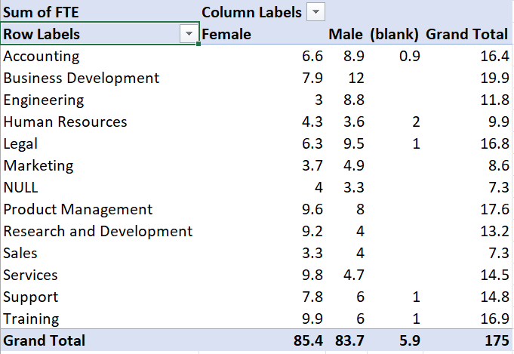
RESULTS:1 TABLE
11

Slide 12
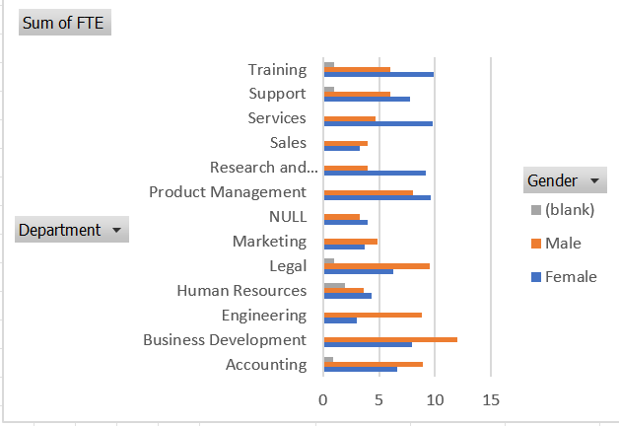
RESULT: 2 BAR DIAGRAM

Slide 13
conclusion
The FTE distribution is generally balanced, with 85.4 FTEs for females and 83.7 for males. However, there are significant gender disparities within specific departments. Engineering and Product Management are predominantly male, whereas Human Resources and Marketing are female-dominated. Additionally, the small number of unclassified FTEs (5.9) suggests potential data gaps. These findings indicate that while the overall gender balance is achieved, certain departments may require focused diversity initiatives to address gender imbalances and ensure equitable representation across the organization.

